Slide 1
MEWP Familiarization:
SE Series
1930SE
2632SE
3346SE
4046SE
4555SE

Slide 2
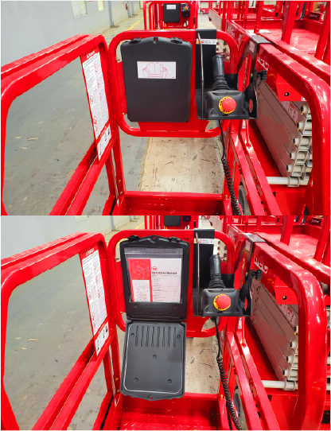
SE Series Familiarization (ANSI A92.22 6.2.5)
6.2.5.1 Prior to user’s authorization of an operator to use a specific model of MEWP, the user must ensure the operator is familiarized on the following, and as specified by the manufacturer.
Do not operate your MEWP until you have read and understood the Manufacturer’s Operator Manual, have performed the workplace inspection, pre-start inspection, routine maintenance, and have completed all the test operations detailed in the operating instructions section of your manual.
Manual location is in manual enclosure on the inside of the front guardrail.
Confirm that the required manual(s) as specified by the manufacturer are with the MEC Micro 19.

Slide 3
Lower Controls
Control |  | Description
1 | Key Switch | PLATFORM | Select to operate from the platform control panel.
 |  | BASE | Select to operate from the base control panel
 |  | OFF | Select to stop operation from either control panel
2 | Platform Lift/Lower Switch | With the Key Switch in the BASE position, move this switch up to lift the platform or down to lower the platform.
3 | Outdoor/Indoor Switch | OUTDOORS INDOORS | Select to limit the maximum height when outdoors. Select to allow unrestricted height when indoors.
4 | Platform Overload | Indicates too much weight on the platform. Remove weight from the platform to restore function and continue.
5 | Emergency Stop Switch | Press the EMERGENCY STOP switch at any time to stop all machine functions. Turn switch clockwise to reset.
6 | 7-Amp Circuit Breaker | Trips when there is excess electrical load. Push to reset.
Purpose and function of controls

Slide 4
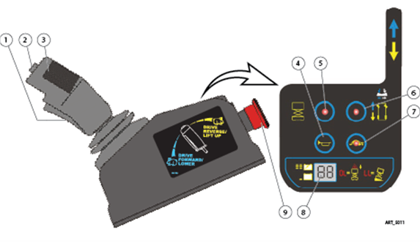
Platform Controls
Control |  | Description
1 | Function Enable Switch | Squeeze to enable DRIVE, STEER, and LIFT functions from the Control Handle.
2 | Steer Switch | Using your thumb, press and hold the rocker switch to steer Left or Right.
3 | Control Handle | DRIVE LIFT | Proportionally controls Forward and Reverse travel. Proportionally controls Lift and Lower Functions
4 | Horn Button | Press to sound warning horn.
5 | Lift Select | Press this button to enable the Lift function. Regardless of if the Function Enable Switch is pressed or released, if no machine movement is made in 10 seconds then the current selection of Lift will time-out. Release then press the Function Enable Switch to reactivate selected function.
6 | Drive Select | Press this button to enable the Drive function. Regardless of if the Function Enable Switch is pressed or released, if no machine movement is made in 10 seconds then the current selection of Drive will time-out. Release then press the Function Enable Switch to reactivate selected function.
7 | Drive Speed Select | Light ON indicates Low Speed Drive is selected. Light OFF indicates High Speed Drive is selected.
8 | LED Display | Indicates the state of battery charge and displays diagnostic codes when necessary.
9 | Emergency Stop Switch | Press the EMERGENCY STOP switch at any time to stop all machine functions. Turn switch clockwise to reset.
Purpose and function of controls

Slide 5
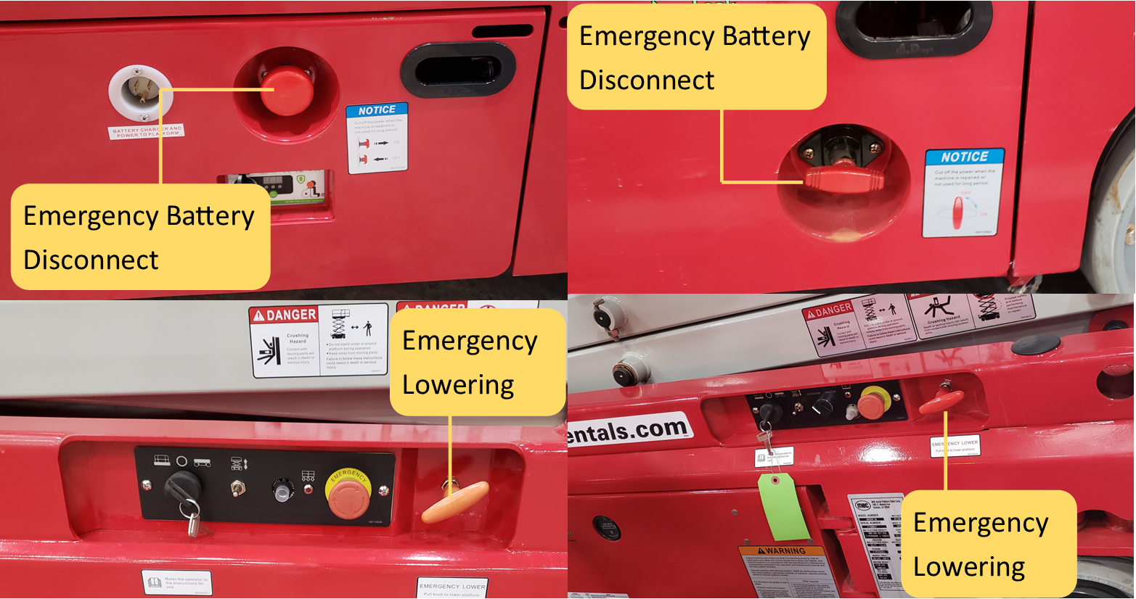
Additional Emergency Controls, Features & Limitations
Feature | 1930SE | 2632SE | 3346SE | 4046SE | 4555SE
Max. Platform Height | 19 ft. | 26 ft. | 33 ft. | 40 ft. | 45 ft.
Max. Platform Capacity | 500 lbs. | 500 lbs. | 750 lbs. | 750 lbs. | 750 lbs.
Deck Extension Capacity | 250 lbs. | 250 lbs. | 250 lbs. | 250 lbs. | 250 lbs.
Deck Extension Persons | 1 per. | 1 per. | 1 per. | 1 per. | 1 per.
Max. Wind Speed | 28 mph | 28 mph | 28 mph | 28 mph | 28 mph
2632SE – 4555SE 1930SE
ELECTROCUTION HAZARD! THIS MACHINE IS NOT INSULATED!
See operator’s manual for additional information and instructions for safe use.
SE Series Familiarization
Features, Limitations and Devices

Slide 6
Operating Characteristics
Features:
Options:
900W Inverter
Proactive Platform Safety System® (PPSS) senses overhead obstructions
36” rollout deck extension
Charger and power to platform connect to single outlet on chassis
Leak Containment System® (LCS)
Tool Tray
Direct electric drive for longer duty cycle
Sheet Material Tray
*See operator’s manual for specific options and feature characteristics.
SE Series Familiarization
Features, Limitations and Devices

Slide 7
For More Information
Contact your local Dealer, Rental Provider or MEC Aerial Work Platforms.
MEC Aerial Work Platforms
+1 (877) 632-5438
info@MECawp.com
MEC Parts
+1 (559) 842-1523
parts@MECawp.com
MEC Product Support
+1 (559) 842-1537
service@MECawp.com
+1 (559) 842-1500
MEC Address & Website
1401 S Madera Ave, Kerman, Ca 93630
www.MECawp.com
This information is provided as product familiarization as called for by ANSI A92.22. and CSA B 354. It is not intended to take the place of information provided by the MEC Operators manual or instruction provided by your equipment supplier. Further, all operators are to be trained before operating this equipment. Please contact MEC Aerial Work Platforms if you require additional information.
Contact Us

