Slide 1
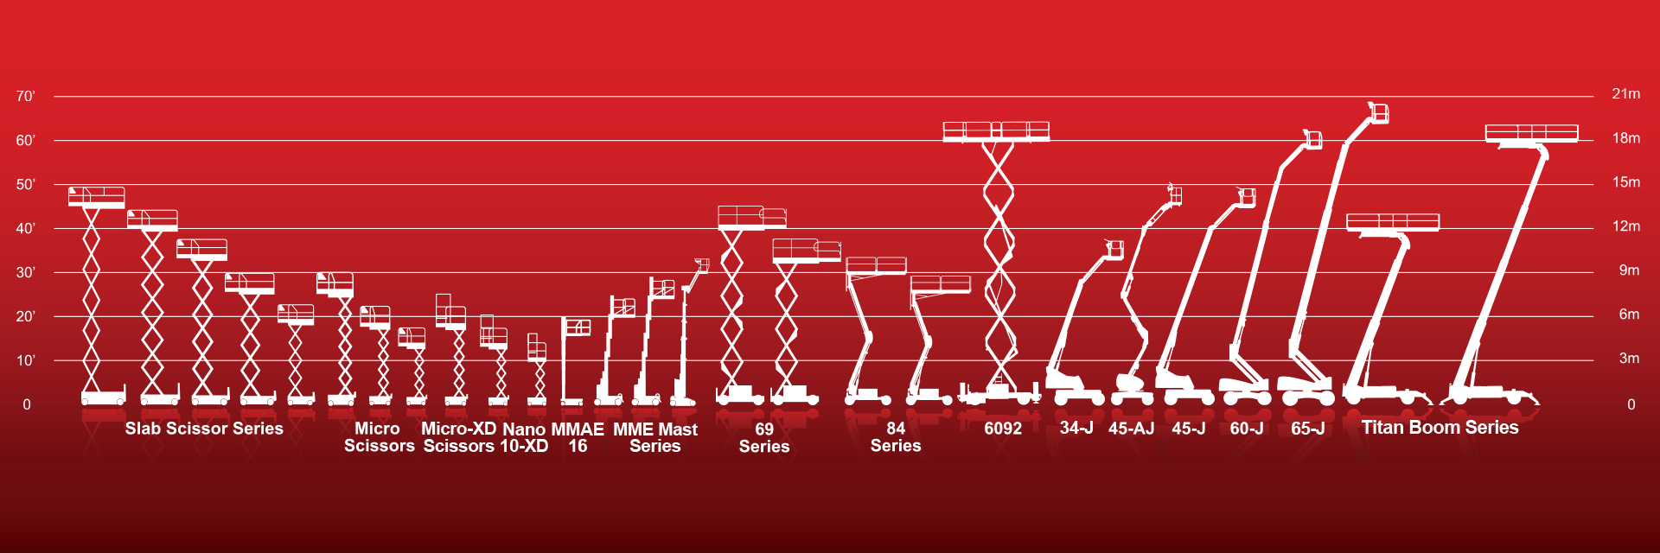

MEWP Familiarization:
MEC® DualReach™ 85-J Boom

Slide 2
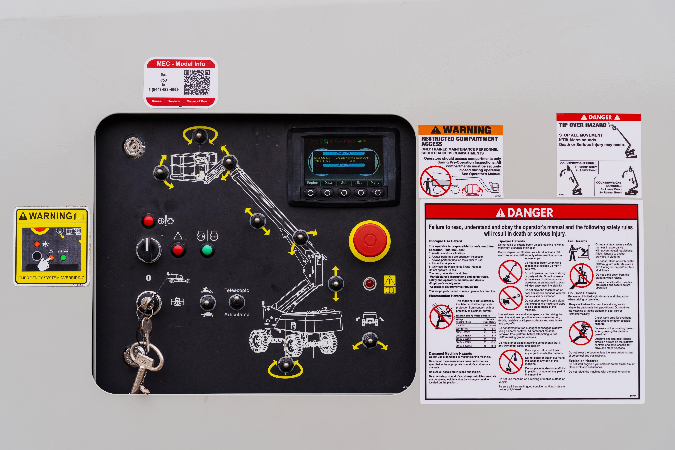
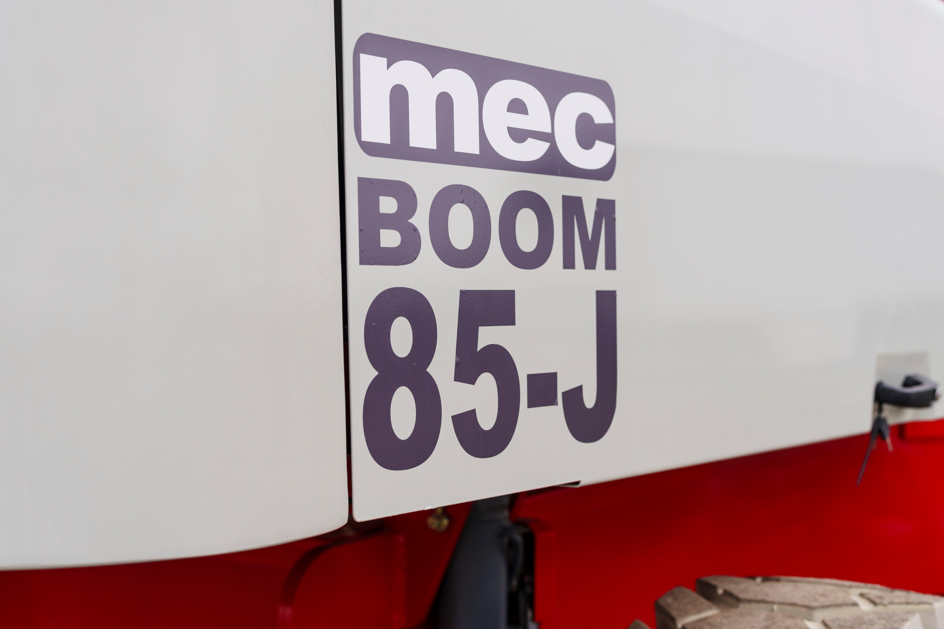
MME30-RJ Familiarization
(ANSI A92.22 6.2.5)
6.2.5.1 Prior to user’s authorization of an operator to use a specific model of MEWP, the user must ensure the operator is familiarized on the following, and as specified by the manufacturer.
Do not operate your MEWP until you have read and understood the Manufacturer’s Operator Manual, have performed the workplace inspection, pre-start inspection, routine maintenance, and have completed all the test operations detailed in the operating instructions section of your manual.
Manual location is in manual enclosure on the inside of the front guardrail.
Confirm that the required manual(s) as specified by the manufacturer are with the MEC DualReach 85-J Boom.
DualReach 85-J Boom Familiarization

Slide 3

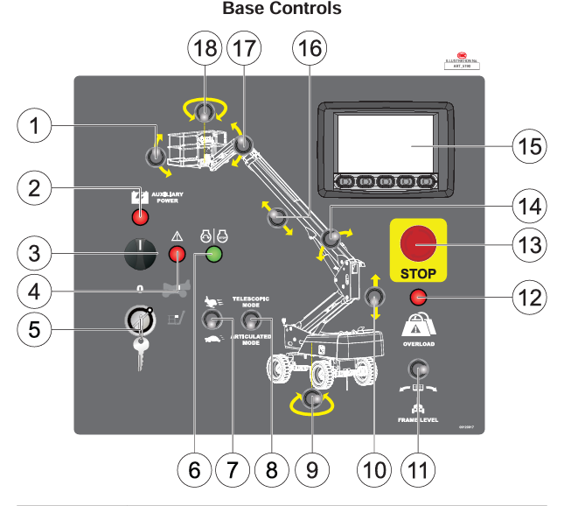
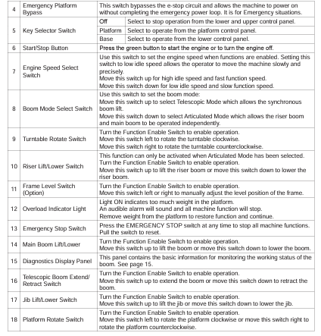
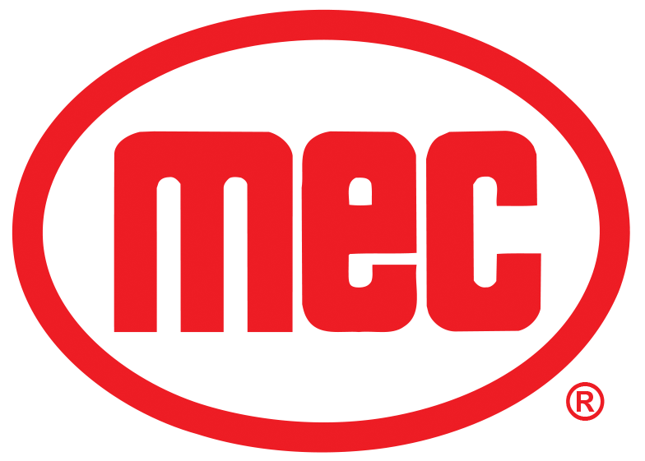
Base Control Panel
Purpose and function of controls

Slide 4
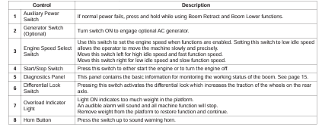
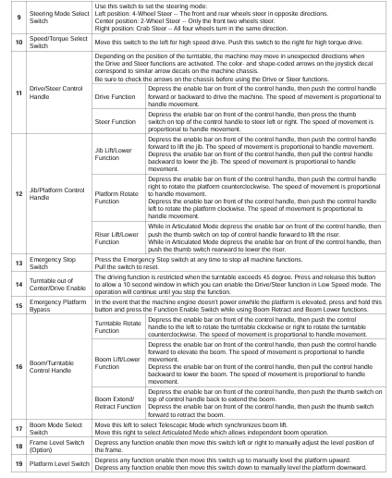
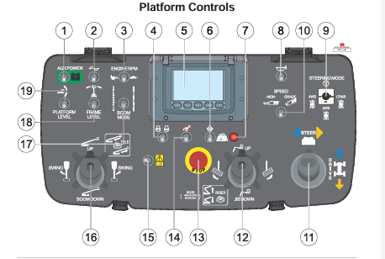
Upper Controls
Purpose and function of controls
DualReach 85-J Boom Familiarization

Slide 5
Operating Characteristics
Features:
Options:
Frame Levelling to Work on Slopes with 7 degree of level ability
Cold Weather Package
Second Year Extended Warranty
Deutz Turbo-Charged Engine Tier 4
Axle-Based 4WD Traction Control Drive
DualReach Selection for Telescopic or Articulated – Two Machines in One
2-Wheel Steer/4-Wheel Steer/Crab Steer Standard
Dual Capacity – 600 lbs. (272 kg) Unrestricted, 900 lbs. (408 kg) Restricted
Solid Rough Terrain Tires
*See operator’s manual for specific options and feature characteristics.
DualReach 85-J Boom Familiarization
Features, Limitations and Devices

Slide 6
For More Information
Contact your local Dealer, Rental Provider or MEC Aerial Work Platforms.
MEC Aerial Work Platforms
+1 (877) 632-5438
info@MECawp.com
MEC Parts
+1 (559) 842-1523
parts@MECawp.com
MEC Product Support
+1 (559) 842-1537
service@MECawp.com
+1 (559) 842-1500
MEC Address & Website
1401 S Madera Ave, Kerman, Ca 93630
www.MECawp.com
This information is provided as product familiarization as called for by ANSI A92.22. and CSA B 354. It is not intended to take the place of information provided by the MEC Operators manual or instruction provided by your equipment supplier. Further, all operators are to be trained before operating this equipment. Please contact MEC Aerial Work Platforms if you require additional information.
Contact Us

