Slide 1
MEWP Familiarization:
MEC® 3232SE

Slide 2
MME30-RJ Familiarization (ANSI A92.22 6.2.5)
6.2.5.1 Prior to user’s authorization of an operator to use a specific model of MEWP, the user must ensure the operator is familiarized on the following, and as specified by the manufacturer.
Do not operate your MEWP until you have read and understood the Manufacturer’s Operator Manual, have performed the workplace inspection, pre-start inspection, routine maintenance, and have completed all the test operations detailed in the operating instructions section of your manual.
Manual location is in manual enclosure on the inside of the front guardrail.
Confirm that the required manual(s) as specified by the manufacturer are with the MEC 3232SE.
3232SE Familiarization

Slide 3
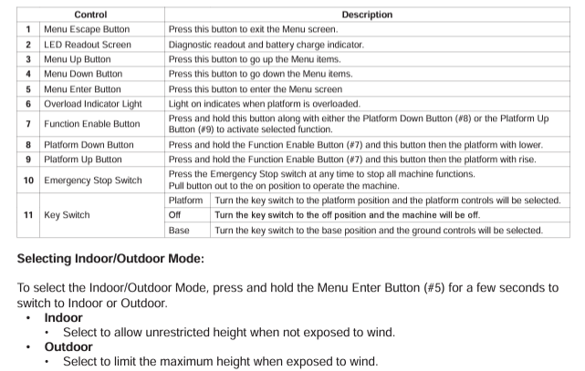
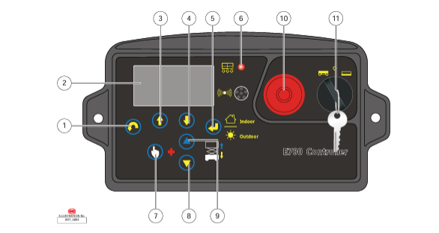
Lower Control Panel
Purpose and function of controls

Slide 4
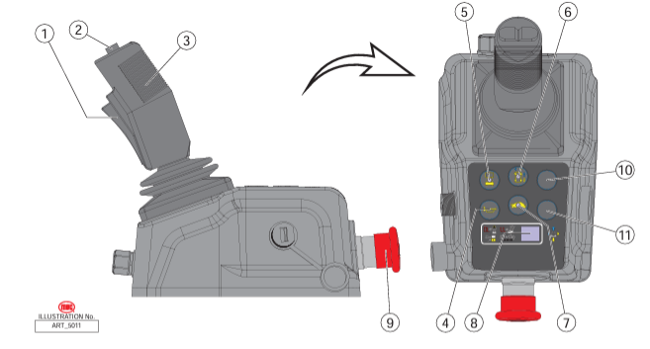
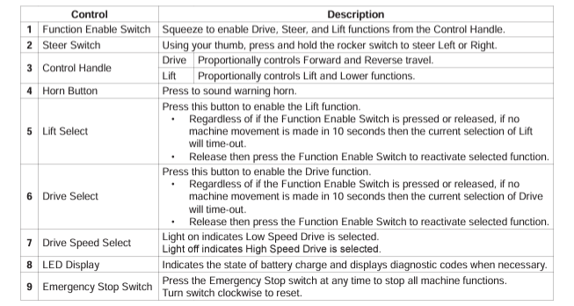
Platform Controls
Purpose and function of controls
3232SE Familiarization

Slide 5
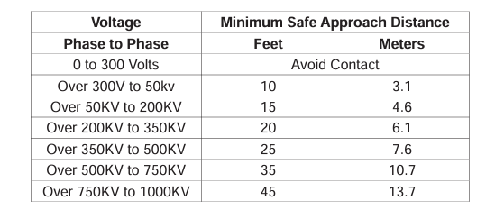
Observe Minimum Safe Approach Distance
Indoor Platform Height: 32 ft (9.75 m) : Outdoor Platform Height 24 ft (7.3 m)
Max. Platform Capacity: 550 lbs., 1 person
Indoor Working Height: 38.5 ft. (10 m) : Outdoor Working Height 30.5 ft (9.3 m)
Max. Wind Speed: 28 mph (45 kph) outdoors
ELECTROCUTION HAZARD! THIS MACHINE IS NOT INSULATED!
See operator's manual for additional information and instructions for safe use.
3232SE Familiarization
Features, Limitations and Devices

Slide 6
Operating Characteristics
Features:
Options:
900W Inverter
Cold Weather Package
Second Year Extended Warranty
AGM Maintenance-Free Batteries Standard
Swing Out Battery and Power Modules
Drives at Full Height Indoors
Outrigger Free Design
AC Electric Drive for Extended Duty Cycles
Fully Proportional Lift and Drive Controls
*See operator’s manual for specific options and feature characteristics.
3232SE Familiarization
Features, Limitations and Devices

Slide 7
For More Information
Contact your local Dealer, Rental Provider or MEC Aerial Work Platforms.
MEC Aerial Work Platforms
+1 (877) 632-5438
info@MECawp.com
MEC Parts
+1 (559) 842-1523
parts@MECawp.com
MEC Product Support
+1 (559) 842-1537
service@MECawp.com
+1 (559) 842-1500
MEC Address & Website
1401 S Madera Ave, Kerman, Ca 93630
www.MECawp.com
This information is provided as product familiarization as called for by ANSI A92.22. and CSA B 354. It is not intended to take the place of information provided by the MEC Operators manual or instruction provided by your equipment supplier. Further, all operators are to be trained before operating this equipment. Please contact MEC Aerial Work Platforms if you require additional information.
Contact Us

