Slide 1
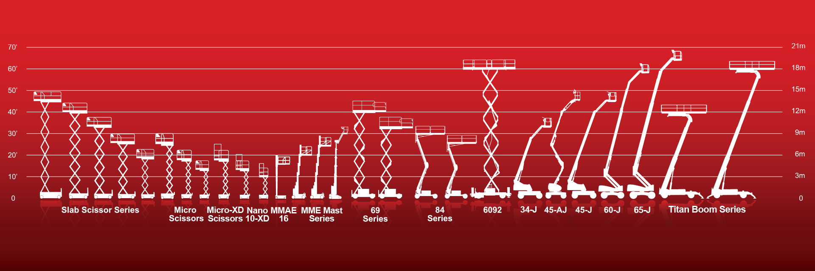

MEWP Familiarization:
MEC® MME30-RJ

Slide 2
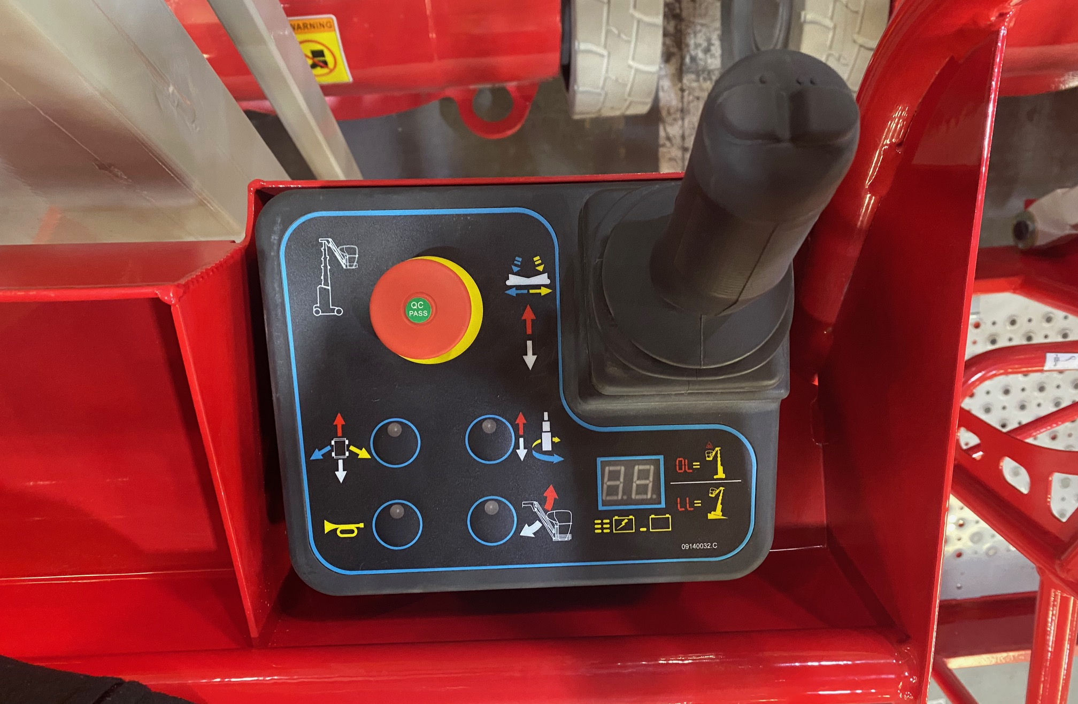
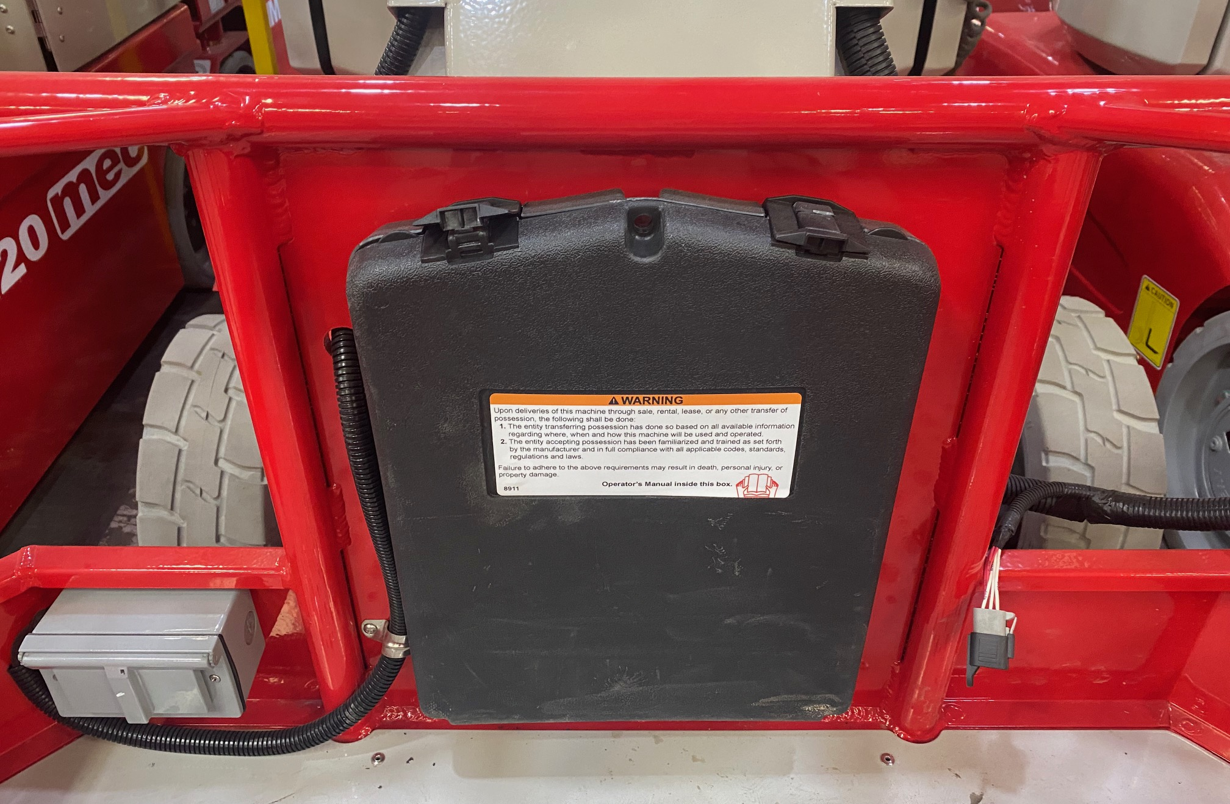
MME30-RJ Familiarization
(ANSI A92.22 6.2.5)
6.2.5.1 Prior to user’s authorization of an operator to use a specific model of MEWP, the user must ensure the operator is familiarized on the following, and as specified by the manufacturer.
Do not operate your MEWP until you have read and understood the Manufacturer’s Operator Manual, have performed the workplace inspection, pre-start inspection, routine maintenance, and have completed all the test operations detailed in the operating instructions section of your manual.
Manual location is in manual enclosure on the inside of the front guardrail.
Confirm that the required manual(s) as specified by the manufacturer are with the MEC MME30-RJ.
MME30-RJ Familiarization

Slide 3
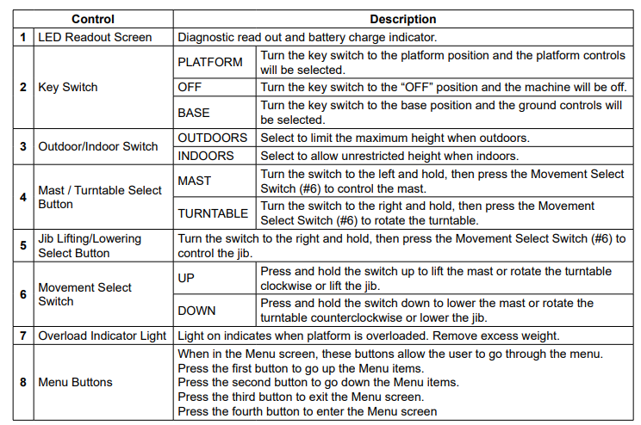
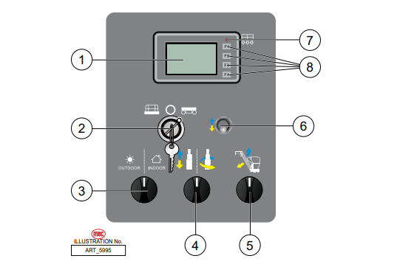

Base Control Panel
Purpose and function of controls

Slide 4
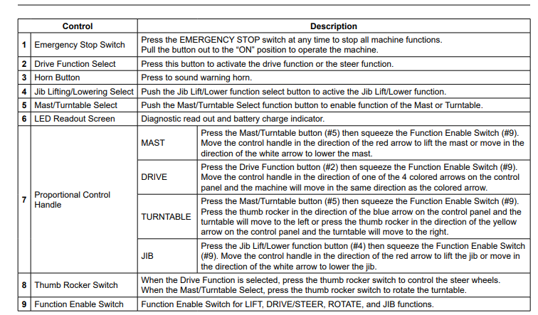
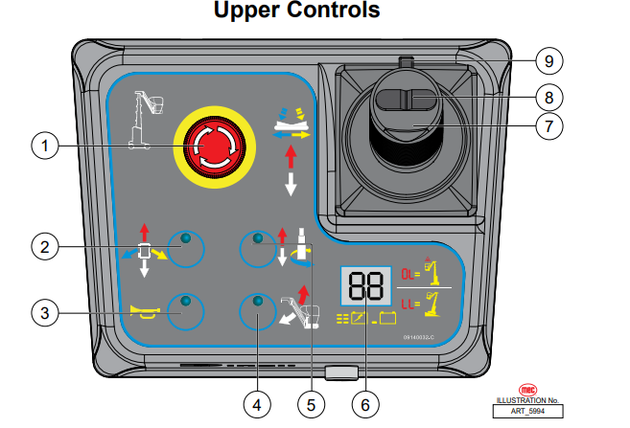
Upper Controls
Purpose and function of controls

Slide 5
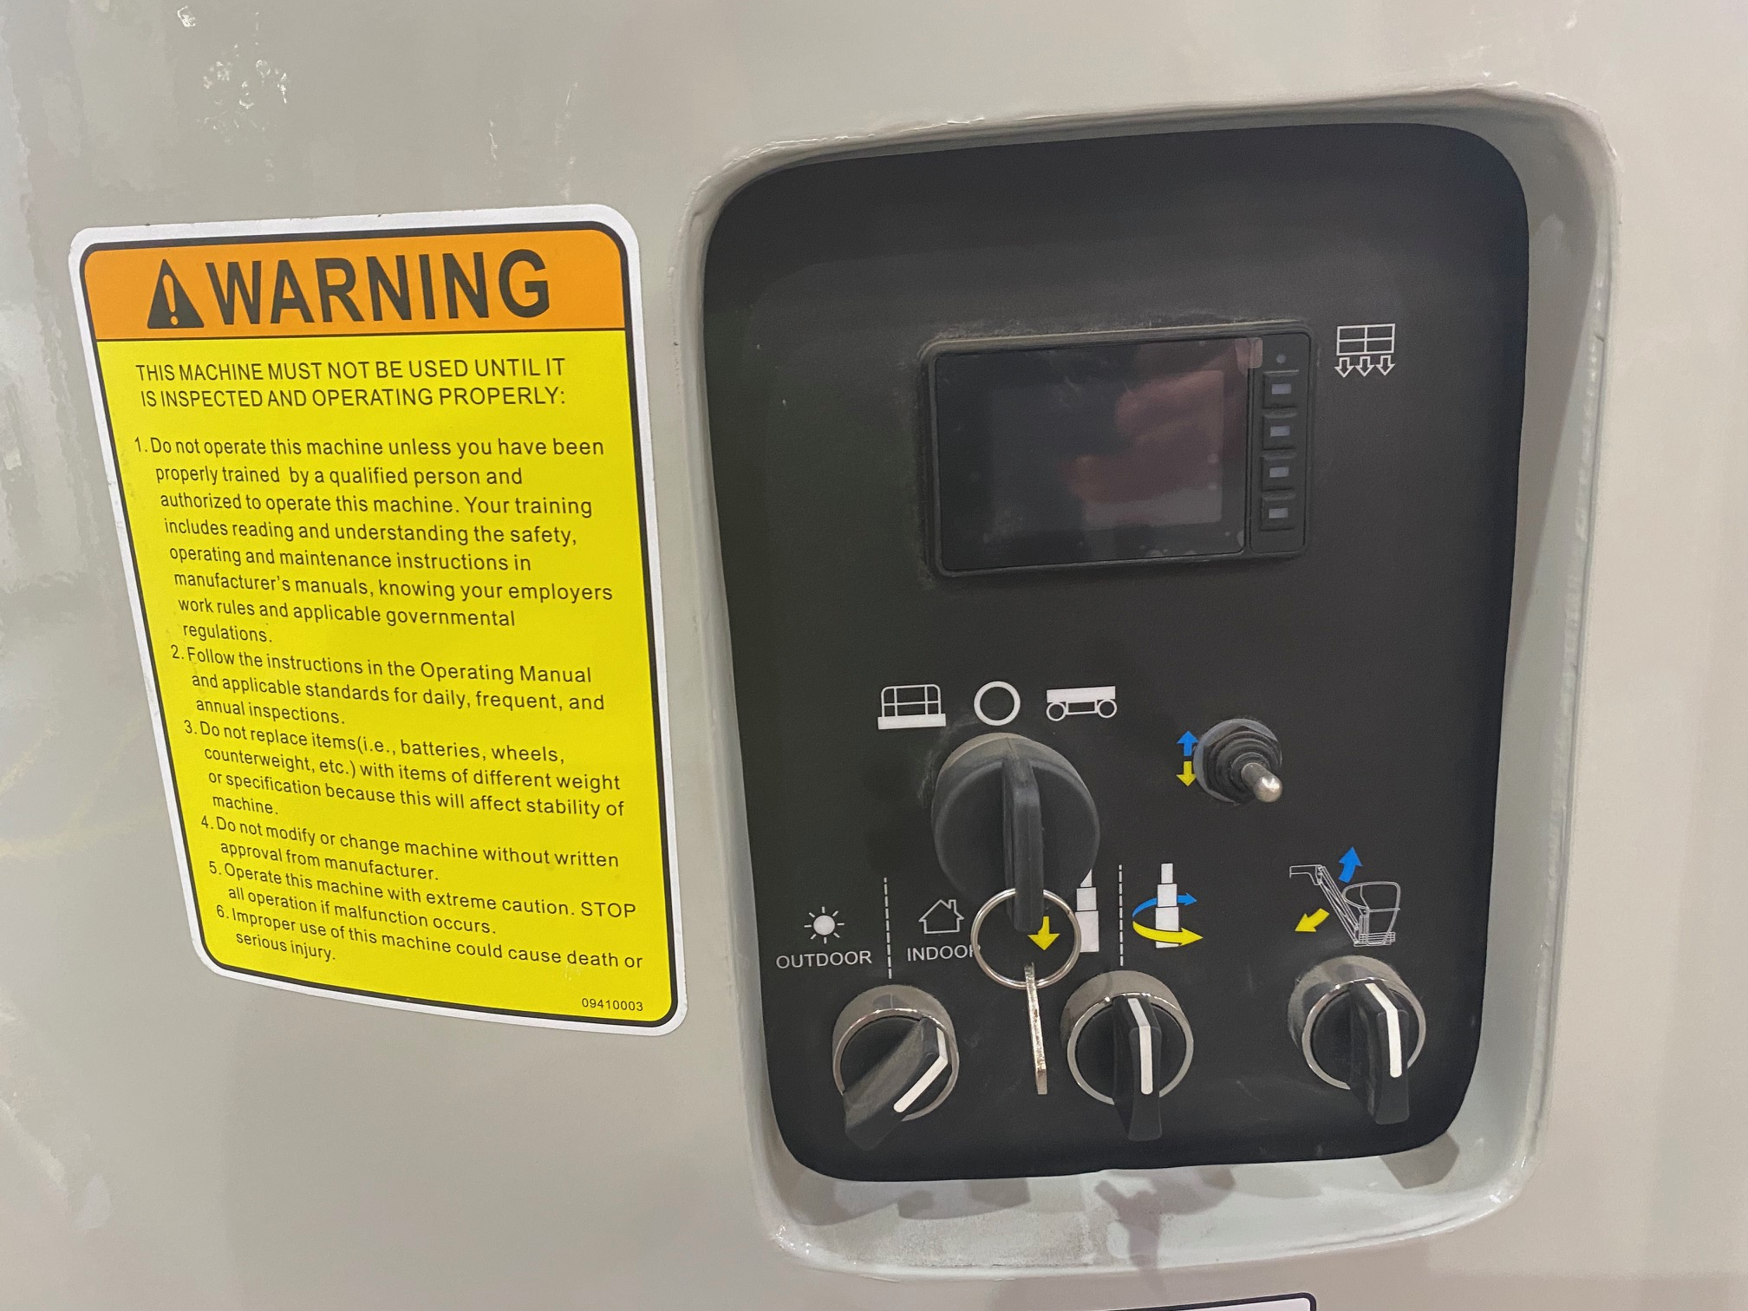
Additional Emergency Controls, Features & Limitations
Indoor Platform Height: 30 ft (9.2 m) : Outdoor Platform Height 27 ft (8.2 m)
Max. Platform Capacity: 500 lbs., 1 person
Maximum Horizontal reach 8 ft. 6 in (2.6 m) : Up and Over height 25 ft. (7.6 m)
Max. Wind Speed: 28 mph (45 kph) outdoors
ELECTROCUTION HAZARD! THIS MACHINE IS NOT INSULATED!
See operator's manual for additional information and instructions for safe use.
MME30-RJ Familiarization
Features, Limitations and Devices

Slide 6
Operating Characteristics
Features:
Options:
900W Inverter
Cold Weather Package
Second Year Extended Warranty
AGM Maintenance-Free Batteries Standard
Right Solution for Up-and-Over Hard to Reach Areas
In-Line Telescopic All-Steel Mast
345-degree Turntable Rotation & Jib
In-line Telescopic All-Steel Mast
Rugged Platform and Gate Construction
*See operator’s manual for specific options and feature characteristics.
MME30-RJ Familiarization
Features, Limitations and Devices

Slide 7
For More Information
Contact your local Dealer, Rental Provider or MEC Aerial Work Platforms.
MEC Aerial Work Platforms
+1 (877) 632-5438
info@MECawp.com
MEC Parts
+1 (559) 842-1523
parts@MECawp.com
MEC Product Support
+1 (559) 842-1537
service@MECawp.com
+1 (559) 842-1500
MEC Address & Website
1401 S Madera Ave, Kerman, Ca 93630
www.MECawp.com
This information is provided as product familiarization as called for by ANSI A92.22. and CSA B 354. It is not intended to take the place of information provided by the MEC Operators manual or instruction provided by your equipment supplier. Further, all operators are to be trained before operating this equipment. Please contact MEC Aerial Work Platforms if you require additional information.
Contact Us

