Slide 1
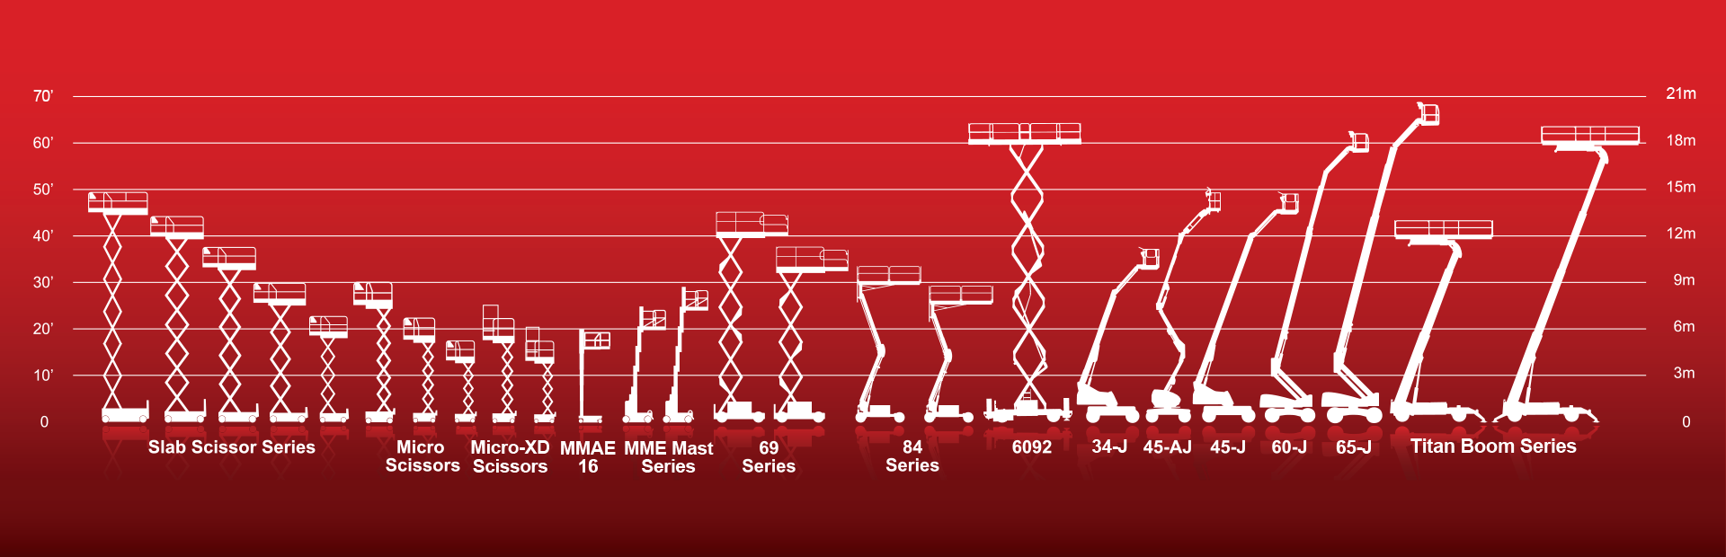

MEWP Familiarization:
MEC NAN010™-XD

Slide 2
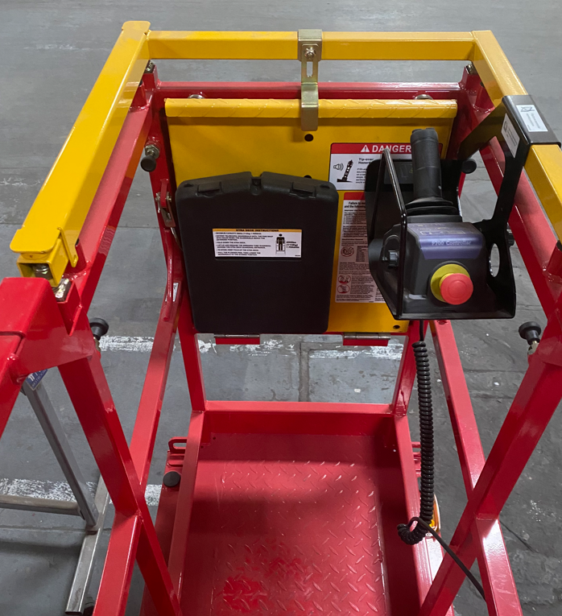
NANO10™-XD Familiarization
(ANSI A92.22 6.2.5)
6.2.5.1 Prior to user’s authorization of an operator to use a specific model of MEWP, the user must ensure the operator is familiarized on the following, and as specified by the manufacturer.
Do not operate your MEWP until you have read and understood the Manufacturer’s Operator Manual, have performed the workplace inspection, pre-start inspection, routine maintenance, and have completed all the test operations detailed in the operating instructions section of your manual.
Manual location is in manual enclosure on the inside of the front guardrail.
Confirm that the required manual(s) as specified by the manufacturer are with the MEC NANO10™-XD.

Slide 3
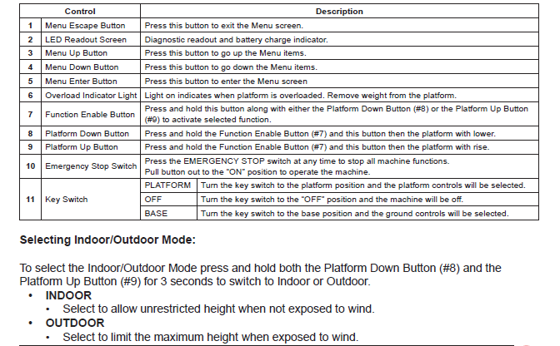
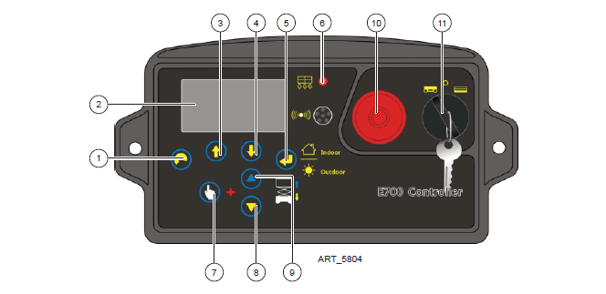

Lower Control Panel
Purpose and function of controls

Slide 4
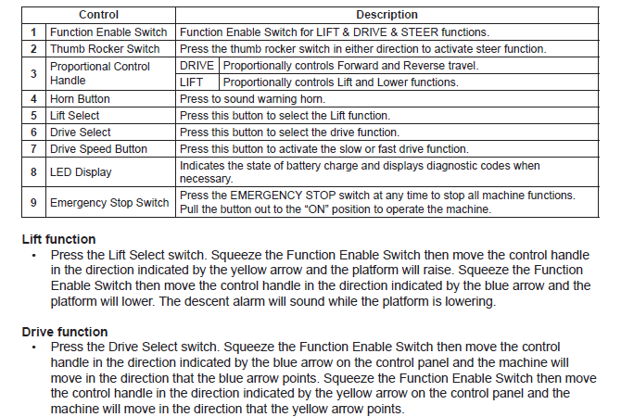
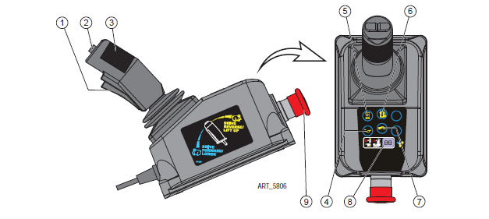
Upper Control Panel
Purpose and function of controls

Slide 5
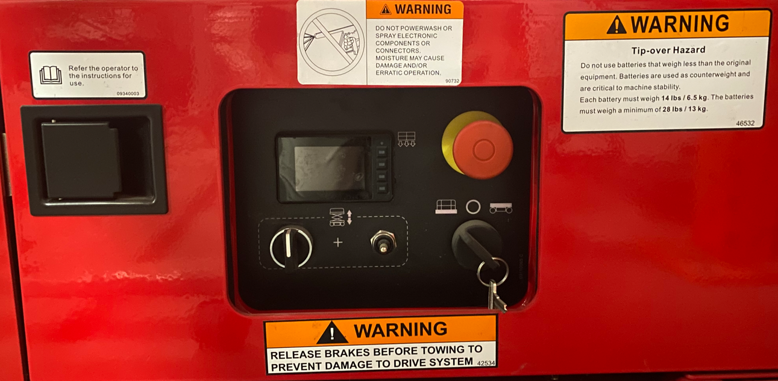
Additional Emergency Controls, Features & Limitations
Max. Platform Height: 9 ft. 8 in. (2.9m) Indoor / 7 ft. 5 in. (2.3m) Outdoor
Max. Platform Capacity: 500 lbs., 1 person
Max. Chassis Inclination: 1.5° side, 3° inline
Max. Wind Speed: 28 mph (45 kph) outdoors
ELECTROCUTION HAZARD! THIS MACHINE IS NOT INSULATED!
See operator's manual for additional information and instructions for safe use.
NANO10™-XD Familiarization
Features, Limitations and Devices

Slide 6
Operating Characteristics
Features:
Options:
Upper Control Box Supplemental Guard
Cold Weather Package
Proactive Platform Safety System® (PPSS) senses overhead obstructions
Second Year Extended Warranty
Non-Marking Tires
2 x 12v 63 A/H Lithium-Ion batteries (Maintenance Free)
All-Electric Drive, Lift & Steer (No Hydraulic Oil)
Up to 9 ft. 8in. Platform Height
Data Centers, Food and Pharmaceutical Applications
Xtra Deck® (20”) Additional Height Platform
Full solution to Ladders Last challenge
*See operator’s manual for specific options and feature characteristics.
NANO10™-XD Familiarization
Features, Limitations and Devices

Slide 7
For More Information
Contact your local Dealer, Rental Provider or MEC Aerial Work Platforms.
MEC Aerial Work Platforms
+1 (877) 632-5438
info@MECawp.com
MEC Parts
+1 (559) 842-1523
parts@MECawp.com
MEC Product Support
+1 (559) 842-1537
service@MECawp.com
+1 (559) 842-1500
MEC Address & Website
1401 S Madera Ave, Kerman, Ca 93630
www.MECawp.com
This information is provided as product familiarization as called for by ANSI A92.22. and CSA B 354. It is not intended to take the place of information provided by the MEC Operators manual or instruction provided by your equipment supplier. Further, all operators are to be trained before operating this equipment. Please contact MEC Aerial Work Platforms if you require additional information.
Contact Us

