Slide 1
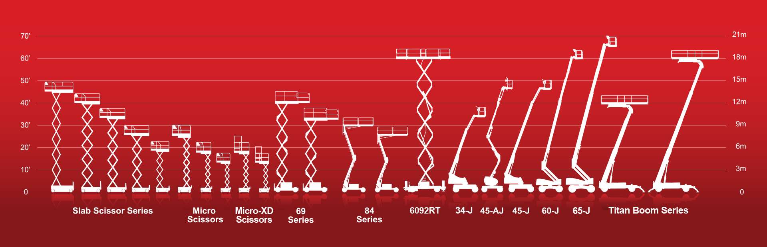

MEWP Familiarization:
MEC MMAE16

Slide 2
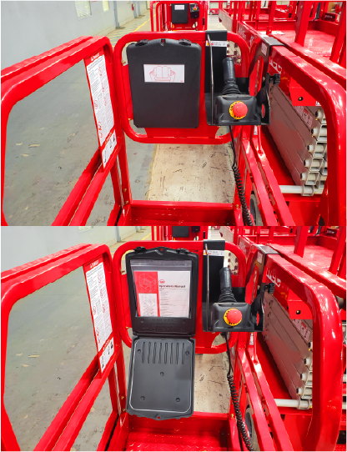
MMAE16 Familiarization
(ANSI A92.22 6.2.5)
6.2.5.1 Prior to user’s authorization of an operator to use a specific model of MEWP, the user must ensure the operator is familiarized on the following, and as specified by the manufacturer.
Do not operate your MEWP until you have read and understood the Manufacturer’s Operator Manual, have performed the workplace inspection, pre-start inspection, routine maintenance, and have completed all the test operations detailed in the operating instructions section of your manual.
Manual location is in manual enclosure on the inside of the front guardrail.
Confirm that the required manual(s) as specified by the manufacturer are with the MEC MME20.

Slide 3
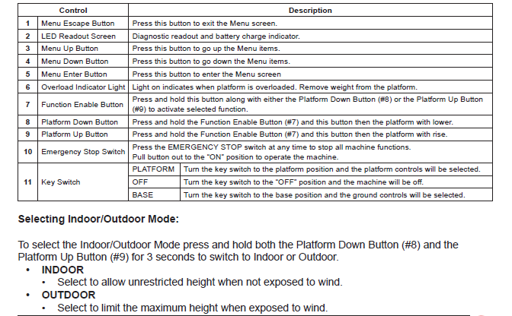
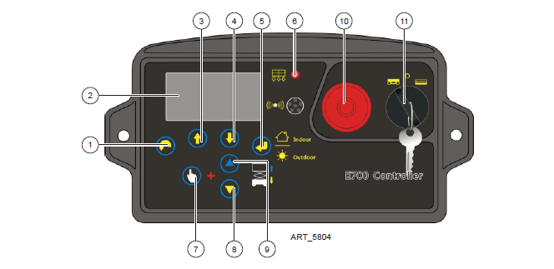

Lower Control Panel
Purpose and function of controls

Slide 4
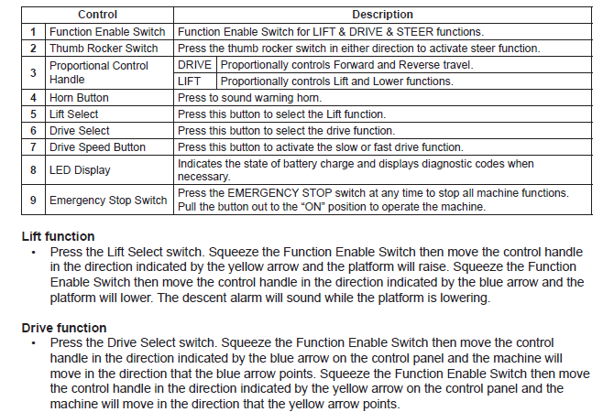
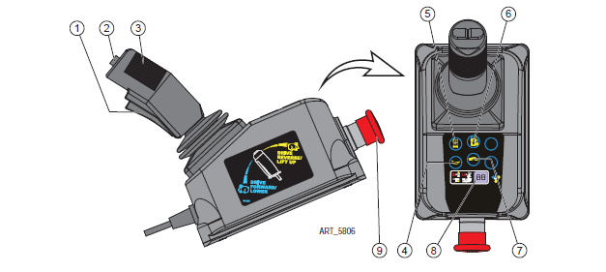
Upper Control Panel
Purpose and function of controls

Slide 5
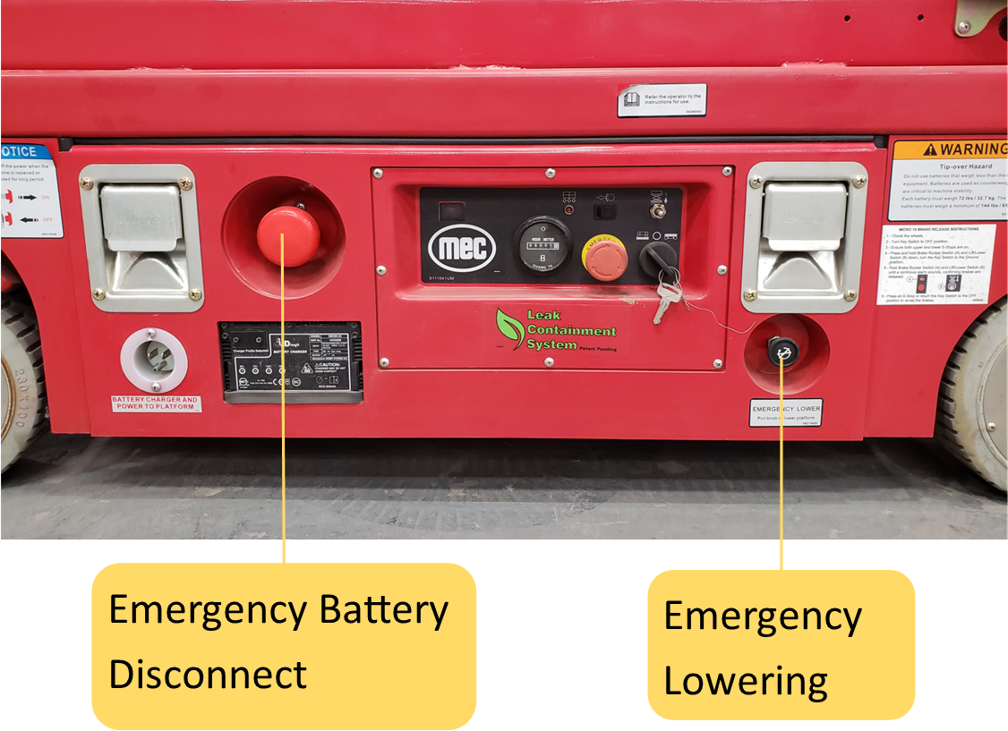
Additional Emergency Controls, Features & Limitations
Max. Platform Height: 16 ft. Indoor / 12 ft. Outdoor
Max. Platform Capacity: 500 lbs., 1 person
Deck Extension Capacity: 250 lbs.
Max. Chassis Inclination: 1.5° side, 3° inline
Max. Wind Speed: 28 mph (45 kph) outdoors
ELECTROCUTION HAZARD! THIS MACHINE IS NOT INSULATED!
See operator's manual for additional information and instructions for safe use.
MMAE16 Familiarization
Features, Limitations and Devices

Slide 6
Operating Characteristics
Features:
Options:
Inverter
Cold Weather Package
Proactive Platform Safety System® (PPSS) senses overhead obstructions
Tool Tray
Second Year Extended Warranty
Non-Marking Tires
Hour Meter
All-Electric Drive, Lift & Steer (No Hydraulic Oil)
Up to 16 ft. Platform Height Indoors and 22 ft. Working Height Outdoors
Roll out Deck Extension (20”) with incremental locking position
Data Centers, Food and Pharmaceutical Applications
*See operator’s manual for specific options and feature characteristics.
MMAE16 Familiarization
Features, Limitations and Devices

Slide 7
For More Information
Contact your local Dealer, Rental Provider or MEC Aerial Work Platforms.
MEC Aerial Work Platforms
+1 (877) 632-5438
info@MECawp.com
MEC Parts
+1 (559) 842-1523
parts@MECawp.com
MEC Product Support
+1 (559) 842-1537
service@MECawp.com
+1 (559) 842-1500
MEC Address & Website
1401 S Madera Ave, Kerman, Ca 93630
www.MECawp.com
This information is provided as product familiarization as called for by ANSI A92.22. and CSA B 354. It is not intended to take the place of information provided by the MEC Operators manual or instruction provided by your equipment supplier. Further, all operators are to be trained before operating this equipment. Please contact MEC Aerial Work Platforms if you require additional information.
Contact Us

